Slide 1
NETWORK SERVICE MESH (NSM) ON KUBERNETES
Quang Tam LE
Telecom Paris-Tech
05th September 2019

Slide 2
Agenda:
1 Quick Introduction
2 Achievements:
Integrated a time-series database into NSM
Implemented on NSM metrics
Deployed NSM lab on OpenStack
3 Conclusions

Slide 3
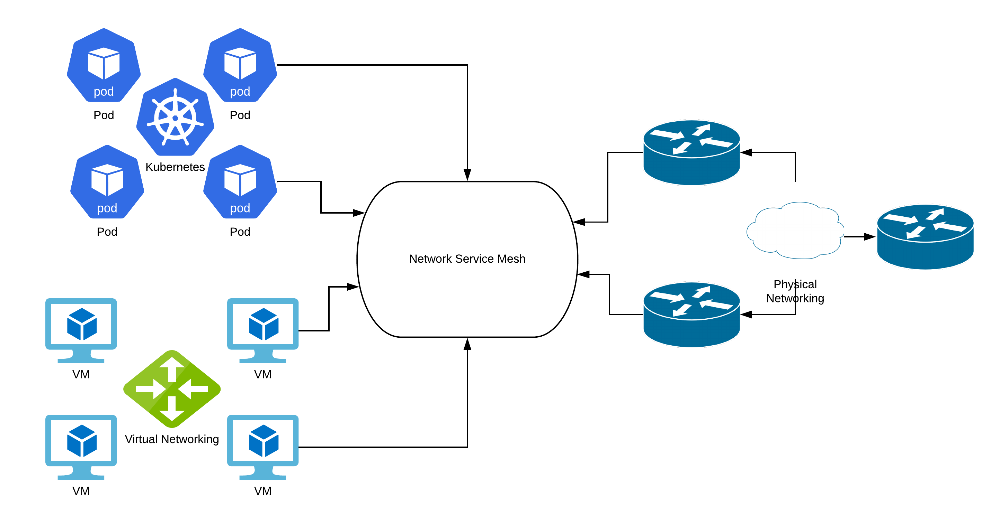
Quick Introduction:
Network Service Mesh is a new solution which provides layer 2/3 connectivity between workloads (pods, VMs, physical devices,...)

Slide 4
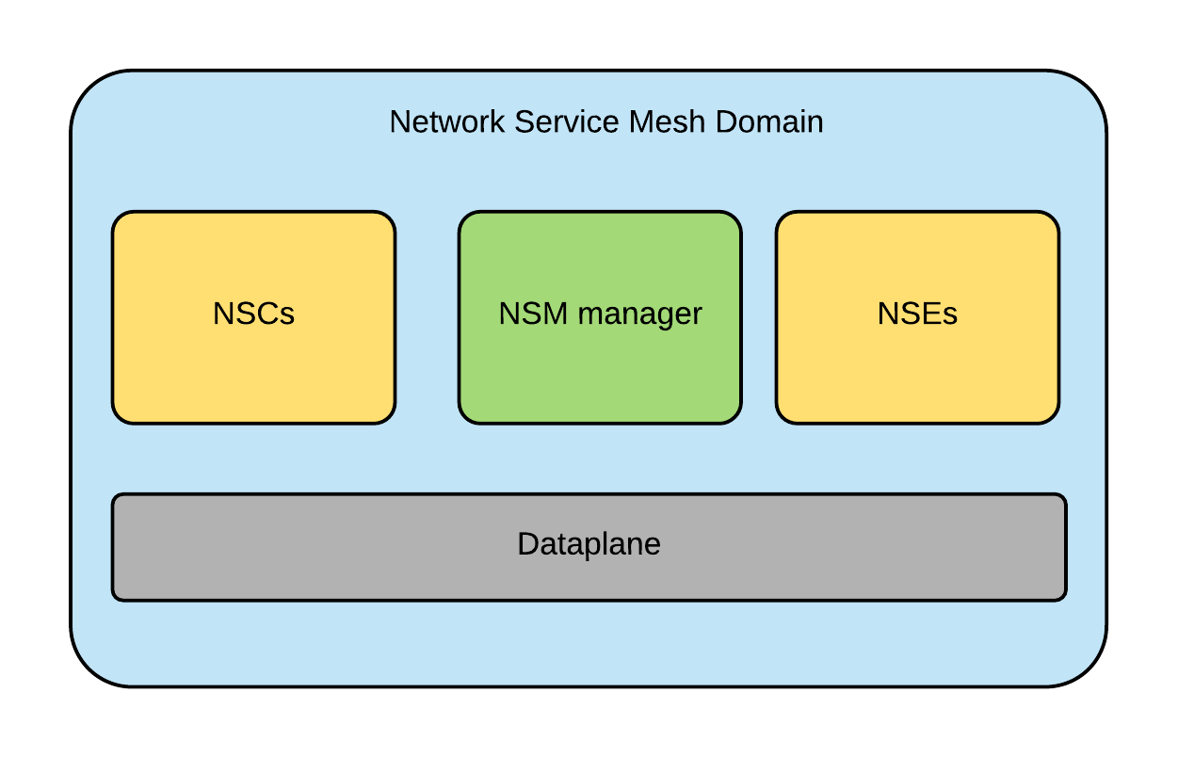
Network Service Mesh Domain

Slide 5
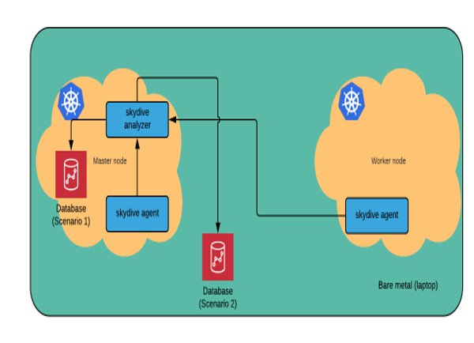
1. Integrated a time-series database into NSM
The goal of this LAB is to integrate a graph and time-series DB (OrientDB,...) into NSM and connect that to Skydive to store all the traffic metrics from the NSM.
2 options for deploying the DB.
Inside nodes
Outside nodes

Slide 6
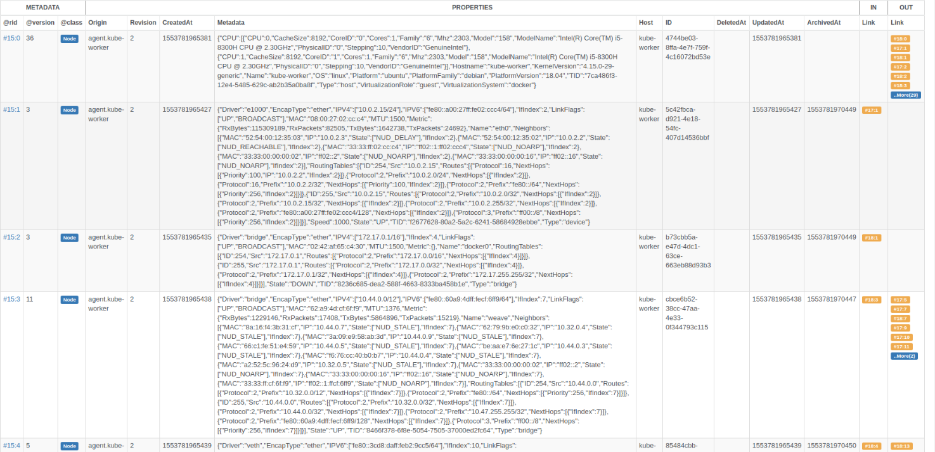
Result

Slide 7
2. Implemented on NSM metrics
NSM collects connection metrics (Rx bytes, Tx bytes,…) but has not using it yet --> I implemented the code to use those metrics for telemetry purposes
There are 2 options for this implementation:
Adding the metrics directly on the metadata of Skydive.
Using third-party apps like AppDynamics, Prometheus,... for statistical and analytical purposes.

Slide 8
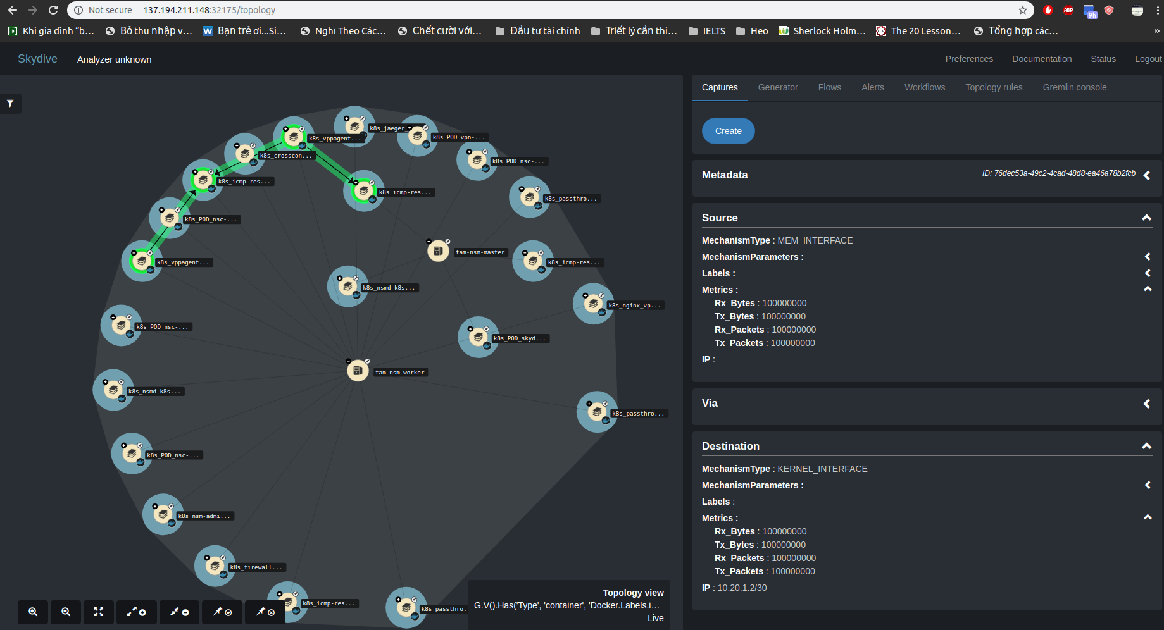
Option 1:
Full pic

Slide 9
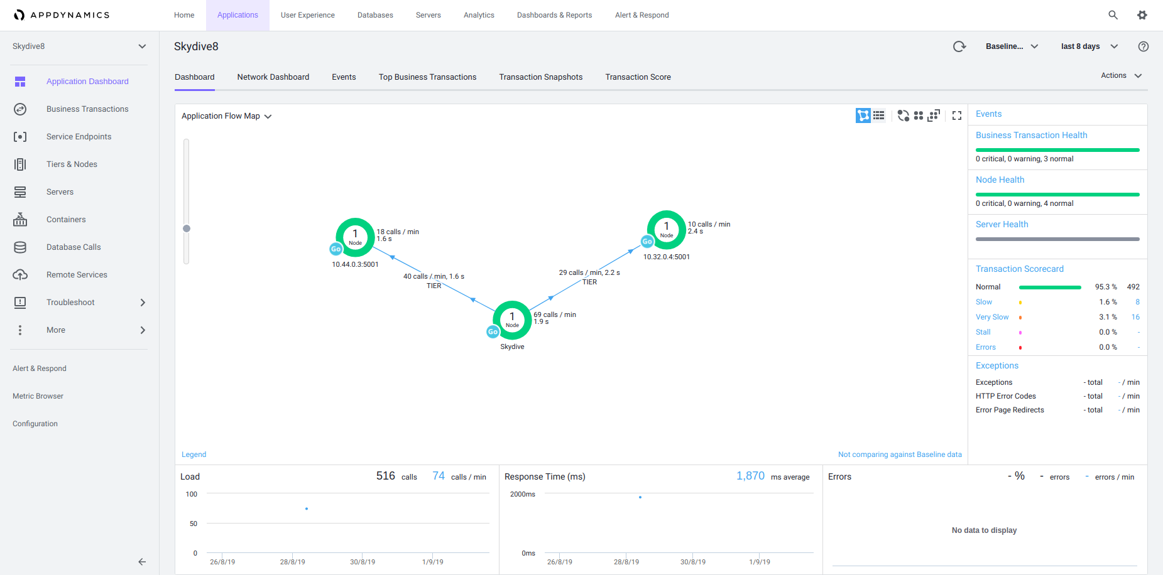
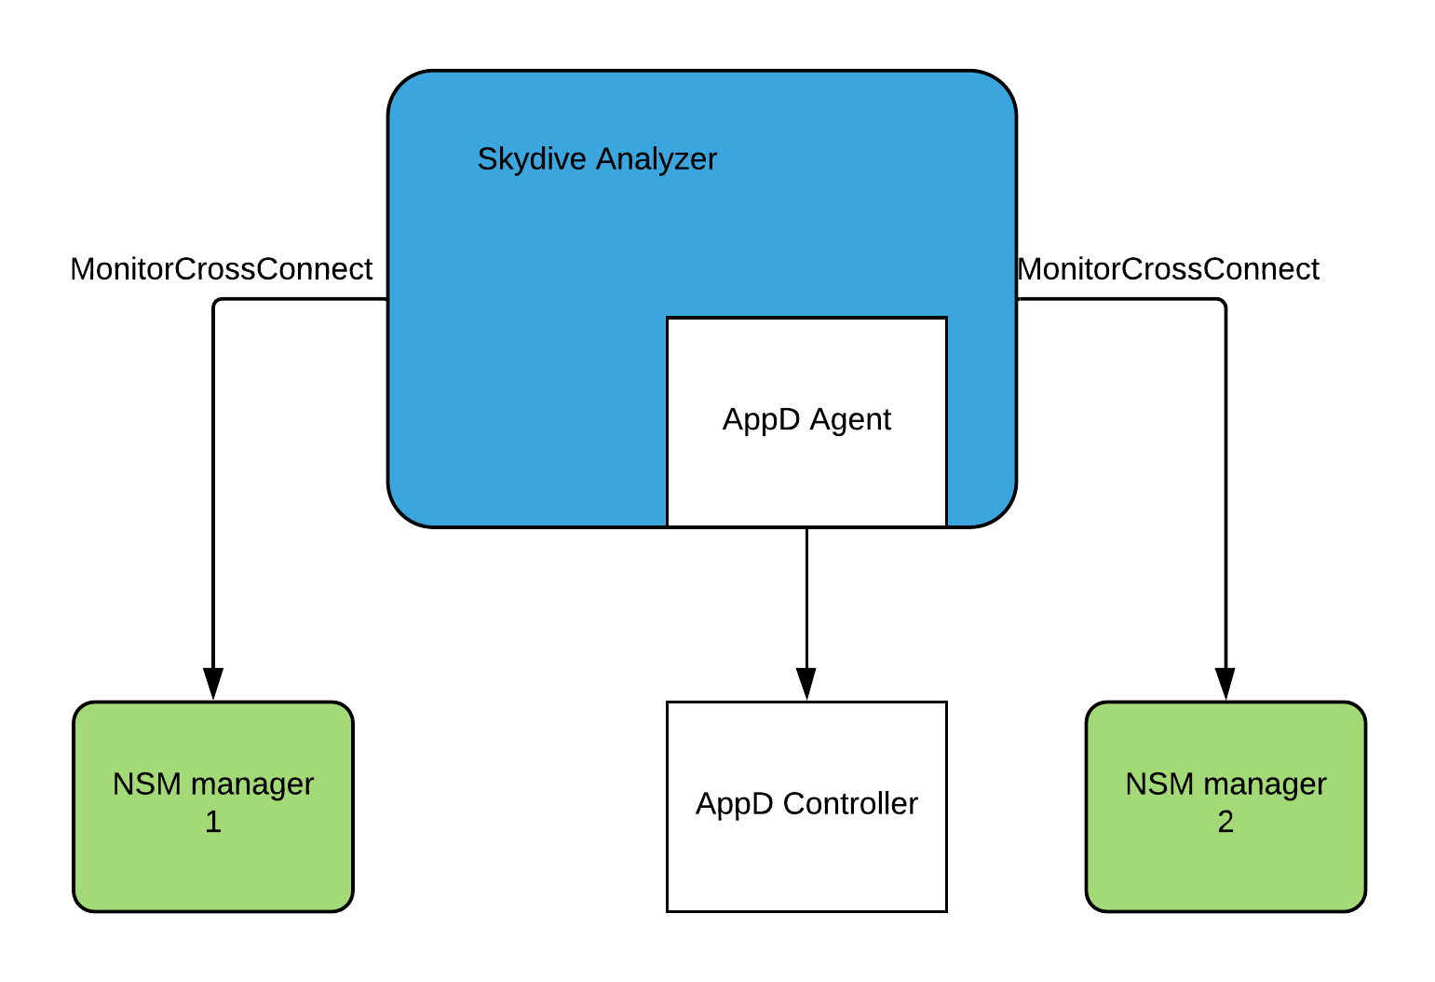
Option 2:

Slide 10
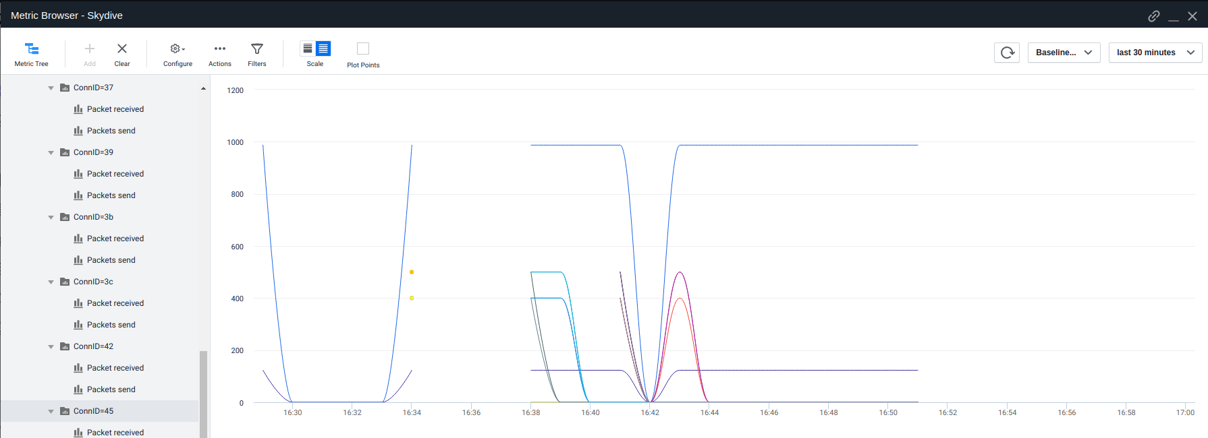
Metrics graph

Slide 11
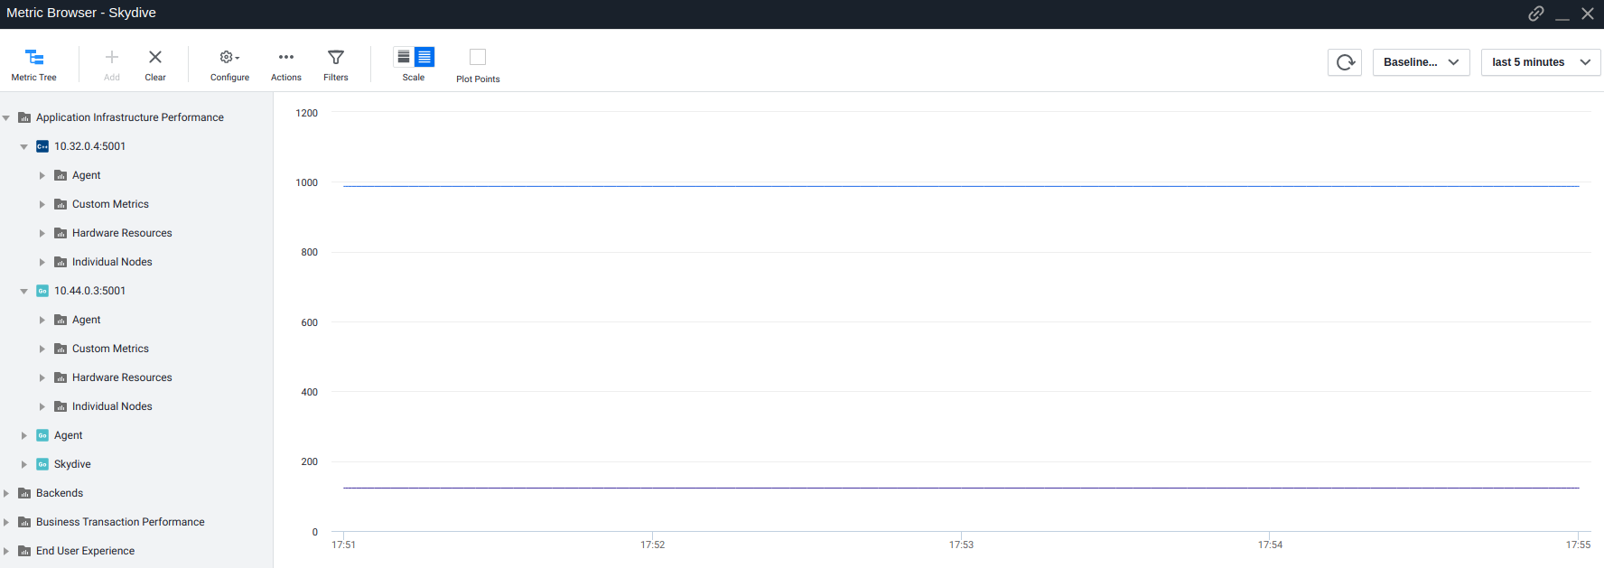

Slide 12
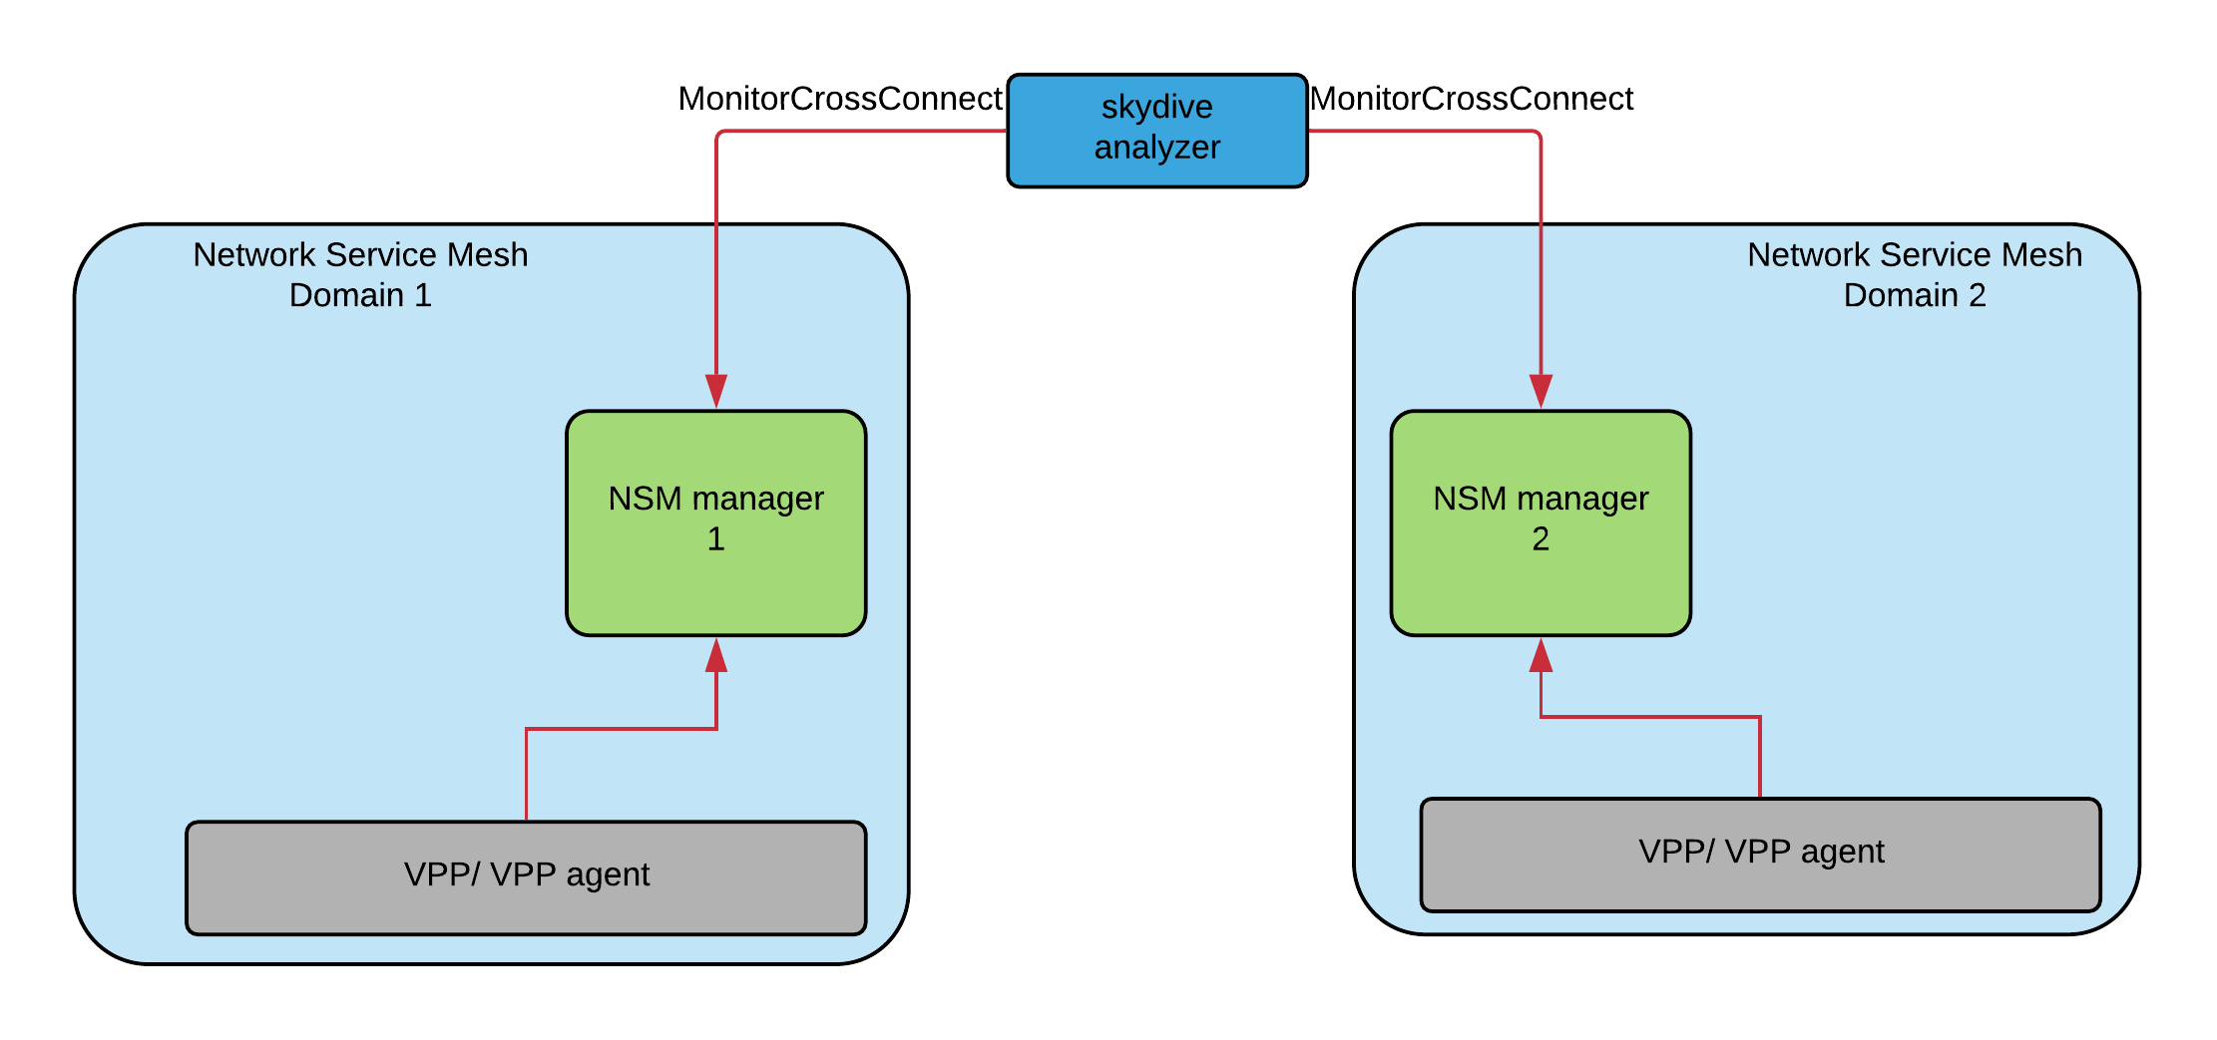
A bug from VPP agent and further discussion
Bug description: VPP agent sends no NSM metrics to NSM managers
Discussion:
https://github.com/ligato/vpp-agent/pull/1451#issuecomment-527046272

Slide 13
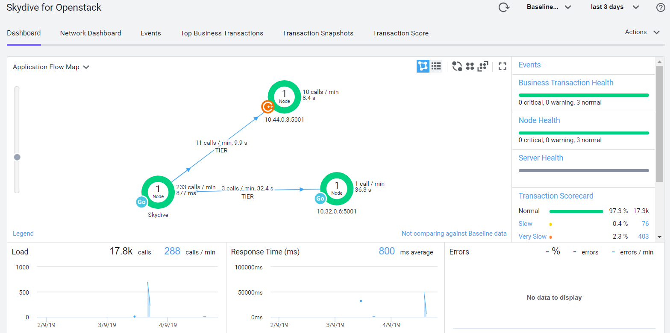
3. Deployed NSM lab on OpenStack

Slide 14
Conclusions:
NSM is a new sandbox project of Cloud Native Computing Foundation CNCF but attracts many attentions from cloud native community.
There are still some problems needed to be addressed. For example: this metrics telemetry or incompatible versions problems --> keep update news on NSM and k8s communities.

Slide 15



